Slide 1
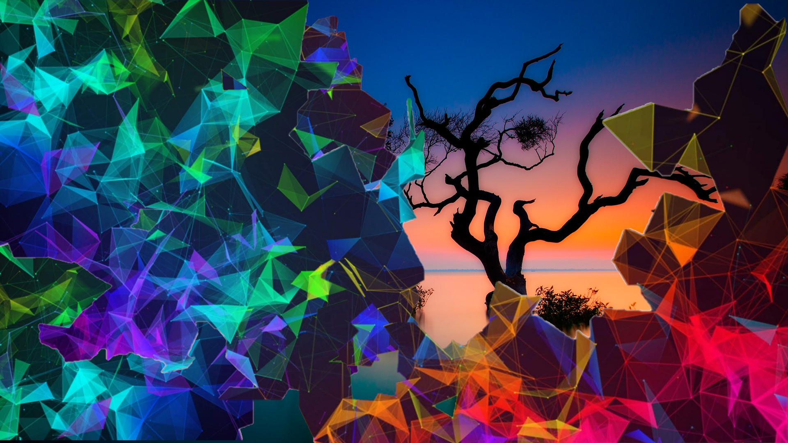
Understanding Neural Radiance Fields
Understanding the concepts behind NeRF and Neural Rendering

Slide 2
Introduction
Before we can jump on to Neural Radiance Fields it is good to be familiar with different areas of computer graphics
Computer Graphics (as per Wikipedia) is a branch of computer science that deals with generating images with the aid of computers
Now computer graphics is a very vast area in itself comprising of multiple topics like UI design, rendering, ray tracing, vector graphics, geometry processing, 3D modeling, image processing, shading, Material and texture, and so on
Every single topic mentioned above is an area of specialization in itself

Slide 3
Rendering
Rendering or image synthesis is a process of generating an image from a 2D or 3D model using a computer program. The resulting image is called render
Rendering is usually the last step in the graphics pipeline which gives models and animations their final appearance.
Any rendering application gets an input file called a scene file. This scene file contains multiple information like for example:
Model (3D or 2D model itself)
Texture
Shading
Shadows
Reflection
Lighting
Viewpoint
The information stated above is considered as a feature for rendering.
It means we can say that each scene file contains multiple features that need to be understood and processed by the rendering algorithm or application to generate a processed image.

Slide 4
Rendering Equation
The rendering algorithm or technique which tries to solve the problem of image generation based on all given features is mostly trying to solve for rendering equation in the most optimized time
At a high-level rendering equation essentially computes for a radiance that is illumination (reflection, refraction, and emittance of light) on an object from a source to an observer in a given space
The reason I brought this up is that NeRF is computing for volume rendering

Slide 5
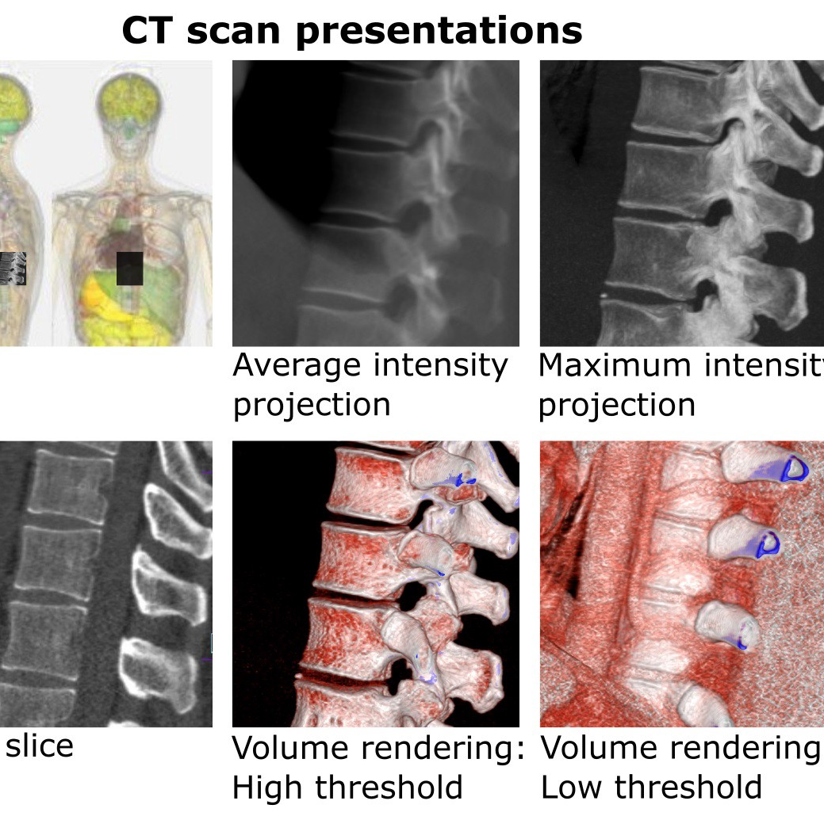
Volume Rendering
Volume rendering (as per Wikipedia) is a set of a technique used to display a 2D projection of a 3D discretely sampled data set.
Now to render such a 2D projection (output) of a 3D dataset we first need to define the camera position in space relative to the volume then we need to define the RGBα (Red, Green. Blue, Alpha → it stands for opacity channel) for every voxel
The primary objective in volume rendering is to get a transfer function which defines RGBα for every value for every possible voxel value in a given space

Slide 6
View Synthesis
Click photos of an object from multiple camera angles and superimpose the images to have a look at the same object from different known camera angles and positions in a given hemispherical plan of the object itself.
This is one of the common techniques of 3D reconstruction from multiple images. For this type of technique, we are trying to predict the third missing axis (the first two being length and breadth) which is the depth.
We try to predict a function for depth determination at various points in the plane against the object itself. This is where the Neural Radiance Fields come into consideration.

Slide 7
Neural Radiance Fields
Generates novel views of complex scenes by optimizing an underlying continuous volumetric scene function using a sparse set of input views
The input can be provided as a blender model or a static set of images.
The input is provided as a continuous 5D function that outputs the radiance emitted in each direction (θ; Φ) at each point (x; y; z) in space, and a density at each point which acts like a differential opacity controlling how much radiance is accumulated by a ray passing through (x; y; z)

Slide 8
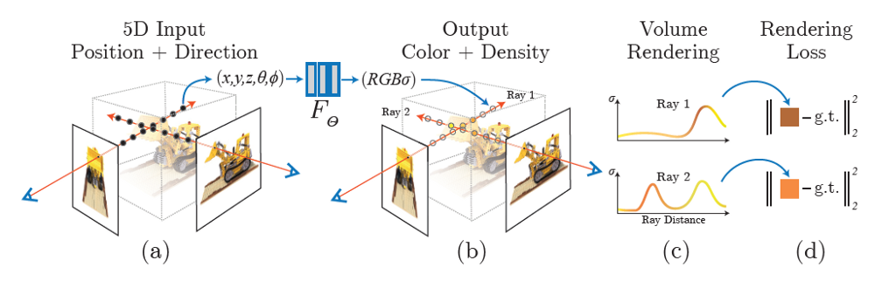
Continuous Scene NeRF optimization
A continuous scene can be described as a 5D vector-valued function whose input is a 3D location x = (x; y; z) and 2D viewing direction (θ; Φ), and whose output is an emitted color c = (r; g; b) and volume density (α).
To generate a Neural Radiance Field from a particular viewpoint following steps were done:
March camera rays through the scene to generate a sampled set of 3D points
Use those points and their corresponding 2D viewing directions as input to the neural network to produce an output set of colors and densities
use classical volume rendering techniques to accumulate those colors and densities into a 2D image

Slide 9
Conclusion
In this article, I tried to give a brief of what computer graphics is and what is the role and contribution of NeRF.
We can summarize by saying that NeRF is doing a reconstruction of scenes by using multiple images as input for a scene
The input is fed to an MLP neural network with a 5D (x; y; z; θ; Φ) input and gives an output of form RGBα.
This output of RGBα is taken as input by any volume rendering algorithm to generate a final view of the scene.
Link: https://medium.com/swlh/nerf-neural-radiance-fields-79531da37734

